Slide 1

Team Details
Team name: SAARTHI
Team leader name: Koushik Deb (solo team)
Problem Statement: Default Prediction Model (Track 04)

Slide 2
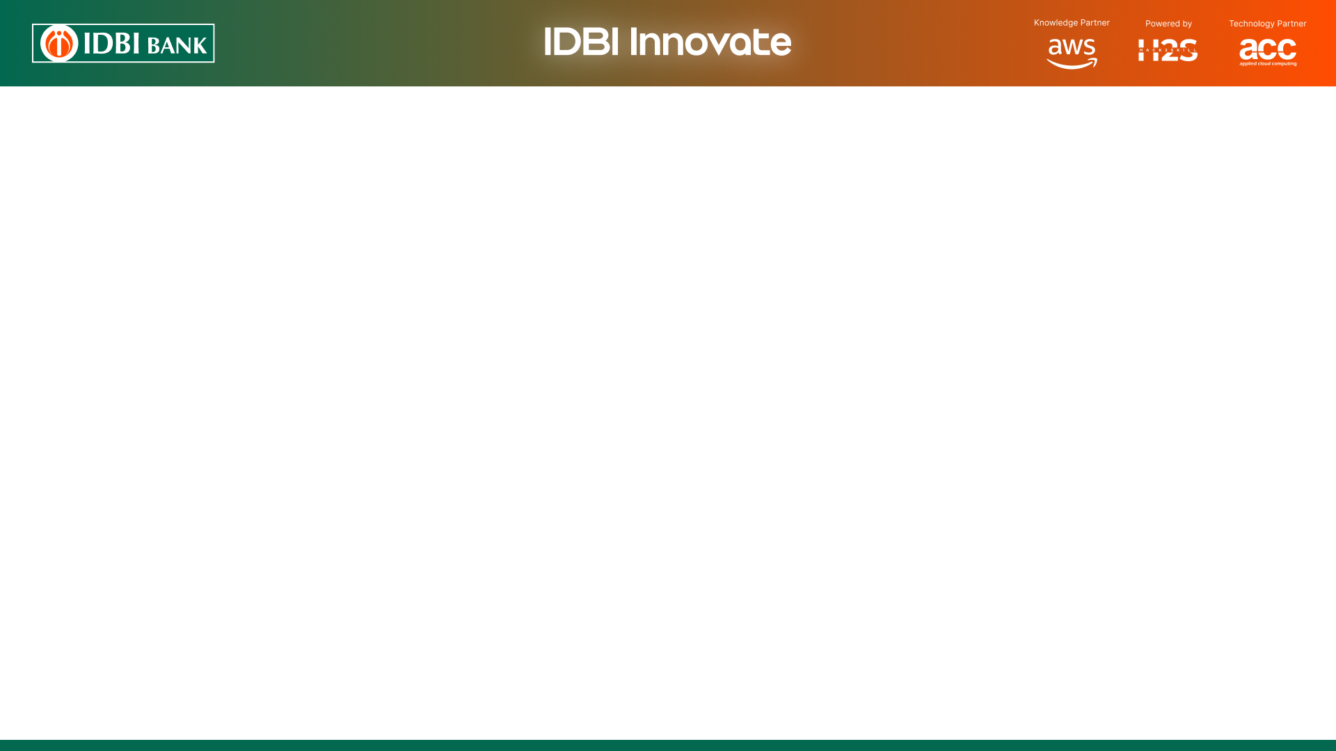
Brief about the idea
SAARTHI turns an MSME loan book into a 12-month early-warning system.
It answers three questions for every borrower: who is likely to default, how soon, and the single change that measurably lowers that risk.
The design rule: the ML model owns every number (probability of default, SHAP drivers, the projected effect of any remedy). The language model owns only words — it picks a code from a fixed 10-item taxonomy and writes the explanation. A second model from a different family then audits that explanation against the SHAP evidence, so nothing reaching a credit officer is invented.
Unlike a static scorecard, SAARTHI ships pre-trained on 3.3M public loans and then fine-tunes on the lender's own book in minutes — on-premise, with no data leaving the bank.

Slide 3
Opportunities
How different is it from any of the other existing ideas?
How will it be able to solve the problem?
USP of the proposed solution
How is it different from existing ideas?
Credit AI today is either accurate but opaque, or explainable but weak. SAARTHI separates the two jobs: numbers come from a calibrated model, words from an LLM, and an independent faithfulness judge verifies the words against the model's own SHAP evidence before a human sees them.
How will it solve the problem?
Defaults are detected at 90+ DPD, when recovery options have closed. SAARTHI flags the risk up to 12 months earlier and pairs each alert with a grounded counterfactual — extend tenure, add collateral, restructure rate — searched on the model itself, not invented by an LLM.
USP
Every explanation is machine-verified, every recommended action carries a model-computed post-action PD, protected attributes never enter the model but are audited for bias, and the whole system runs inside the bank's own environment.

Slide 4
List of features offered by the solution
Automatic column mapping — upload any loan book; an LLM maps your columns onto a canonical schema, with a deterministic fallback and user confirmation.
Calibrated probability of default — isotonic-calibrated, so the score is a real probability, not a rank.
12-month risk curve — survival model shapes when risk accrues; flags the month the borrower crosses the alert threshold.
Verified reason codes — fixed 10-code taxonomy grounded in SHAP, checked by an independent judge model for invented factors and flipped signs.
Actionable recourse — greedy counterfactual search over actionable levers only, returning the projected PD after the change.
Difference-aware fairness audit — protected attributes are never model inputs; disparities are flagged only when they persist among same-risk applicants.
Transaction-as-language — a self-supervised encoder reads raw transaction narration sequences, adding signal where curated fields are sparse.
Full transparency — live model trace showing which provider and model answered, and whether each explanation passed its judge.

Slide 5
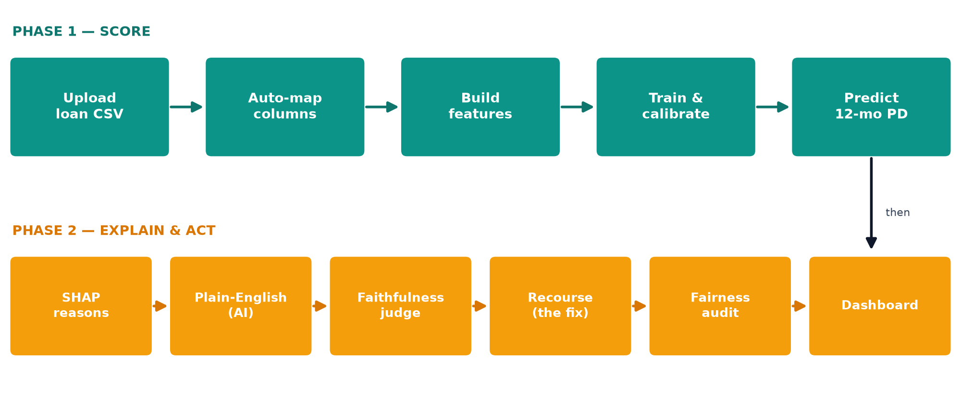
Process flow diagram or Use-case diagram

Slide 6
Wireframes/Mock diagrams of the proposed solution (optional)

Slide 7
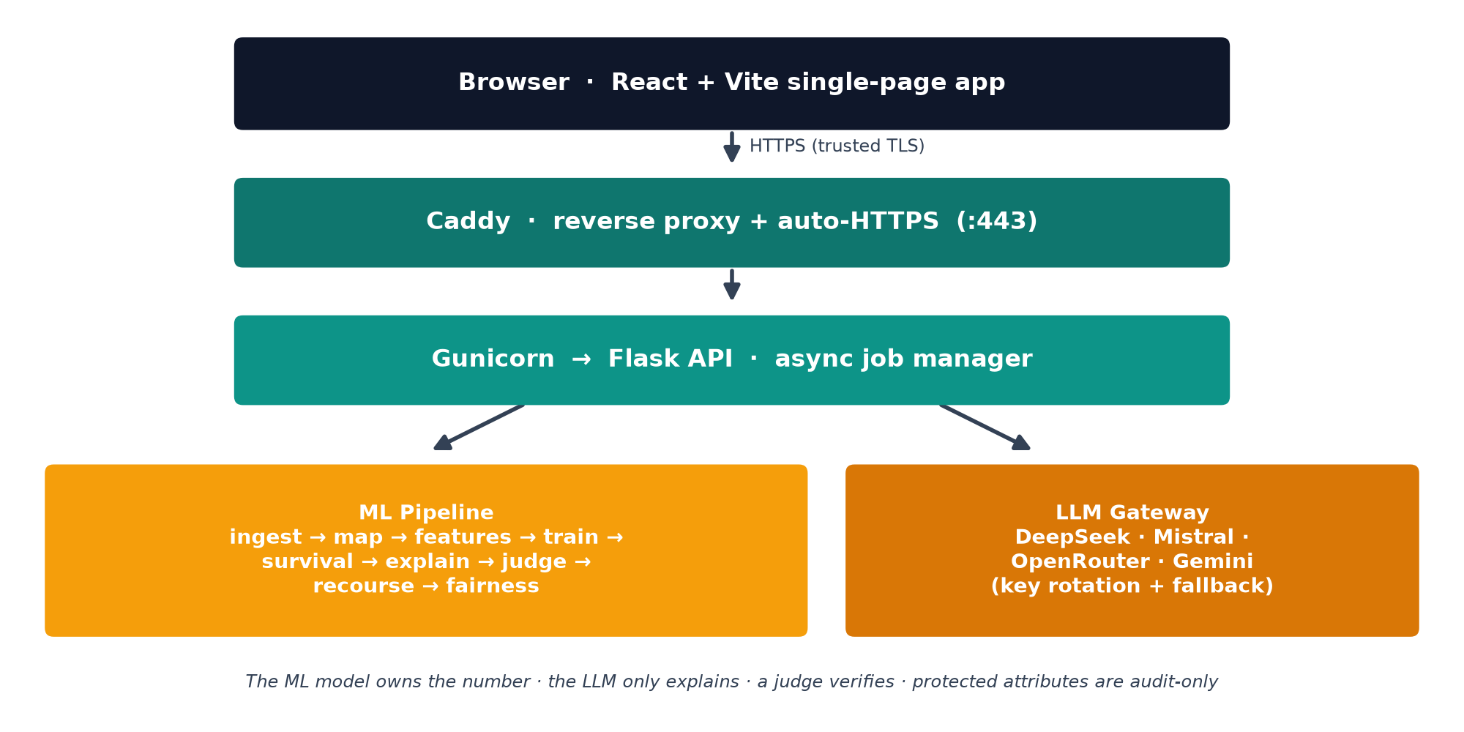
Architecture diagram of the proposed solution

Slide 8
Technologies to be used in the solution
Machine learning
LightGBM · XGBoost · CatBoost ensemble, isotonic calibration (scikit-learn) · SHAP TreeExplainer · lifelines (Cox survival) · fairlearn (bias audit) · PyTorch (CoLES transaction-sequence encoder)
Language models
Multi-provider gateway over an OpenAI-compatible interface — DeepSeek, Mistral, OpenRouter, Gemini — with role-based fallback chains, key rotation and a cross-family judge. AWS Bedrock adapter for in-bank deployment.
Application
Backend: Python 3.11, Flask, Gunicorn, pandas/polars, pydantic. Frontend: React 18, TypeScript, Vite, TailwindCSS, Recharts. Serving: Caddy with automatic HTTPS, systemd, Linux VPS.
Training data
Nine public credit corpora — SBA, Lending Club, Home Credit, Give Me Some Credit, Taiwan, German, Berka, Amex, IBM TabFormer. No bank data was used at any stage.

Slide 9
Estimated implementation cost (optional)
Prototype built end-to-end for under one US dollar.
Item | Spec | Cost
GPU (sequence encoder training) | RTX 2080 Ti, vast.ai, ~1 h | $0.08
CPU training (all other models) | existing 32-core VPS | $0.00
Datasets | 9 public corpora, ~15 GB | $0.00
Hosting (demo) | VPS + Caddy, automatic HTTPS | existing
LLM inference | free-tier / low-cost API keys | < $1
Production estimate (per bank):
Inference is CPU-only and runs on-premise; a single mid-size VM scores a 150,000-loan portfolio per run. The only recurring cost is LLM inference for explanations, which is bounded by generating them for the top-risk loans eagerly and the rest lazily on demand.

Slide 10
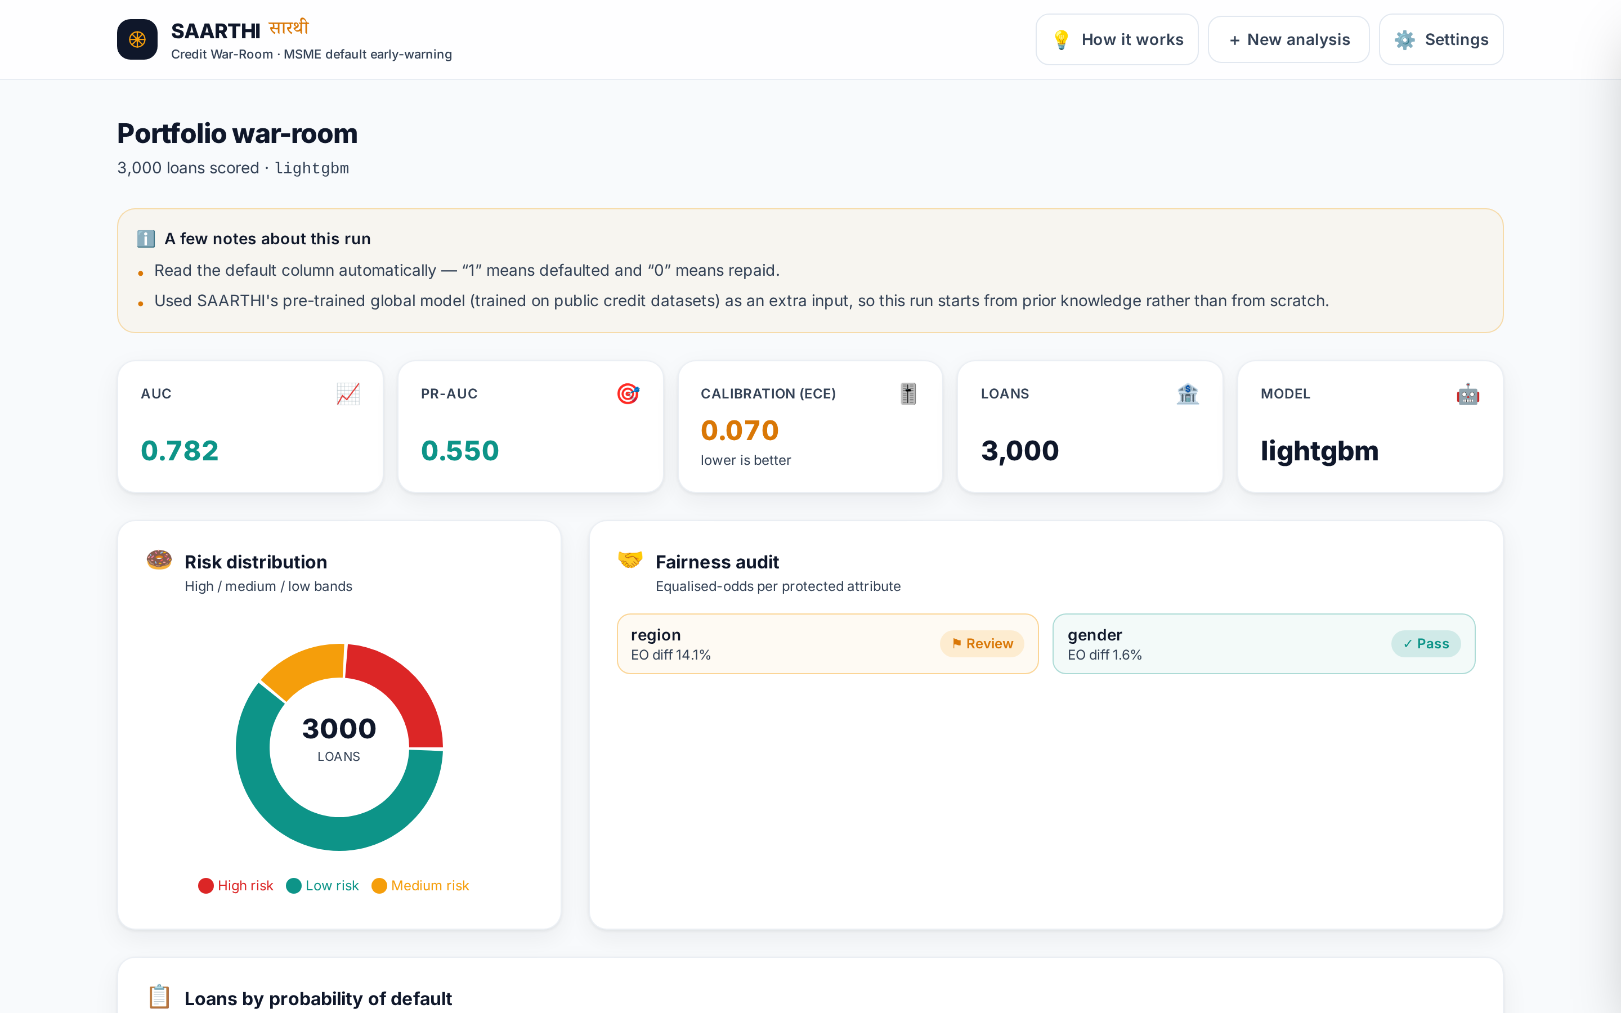
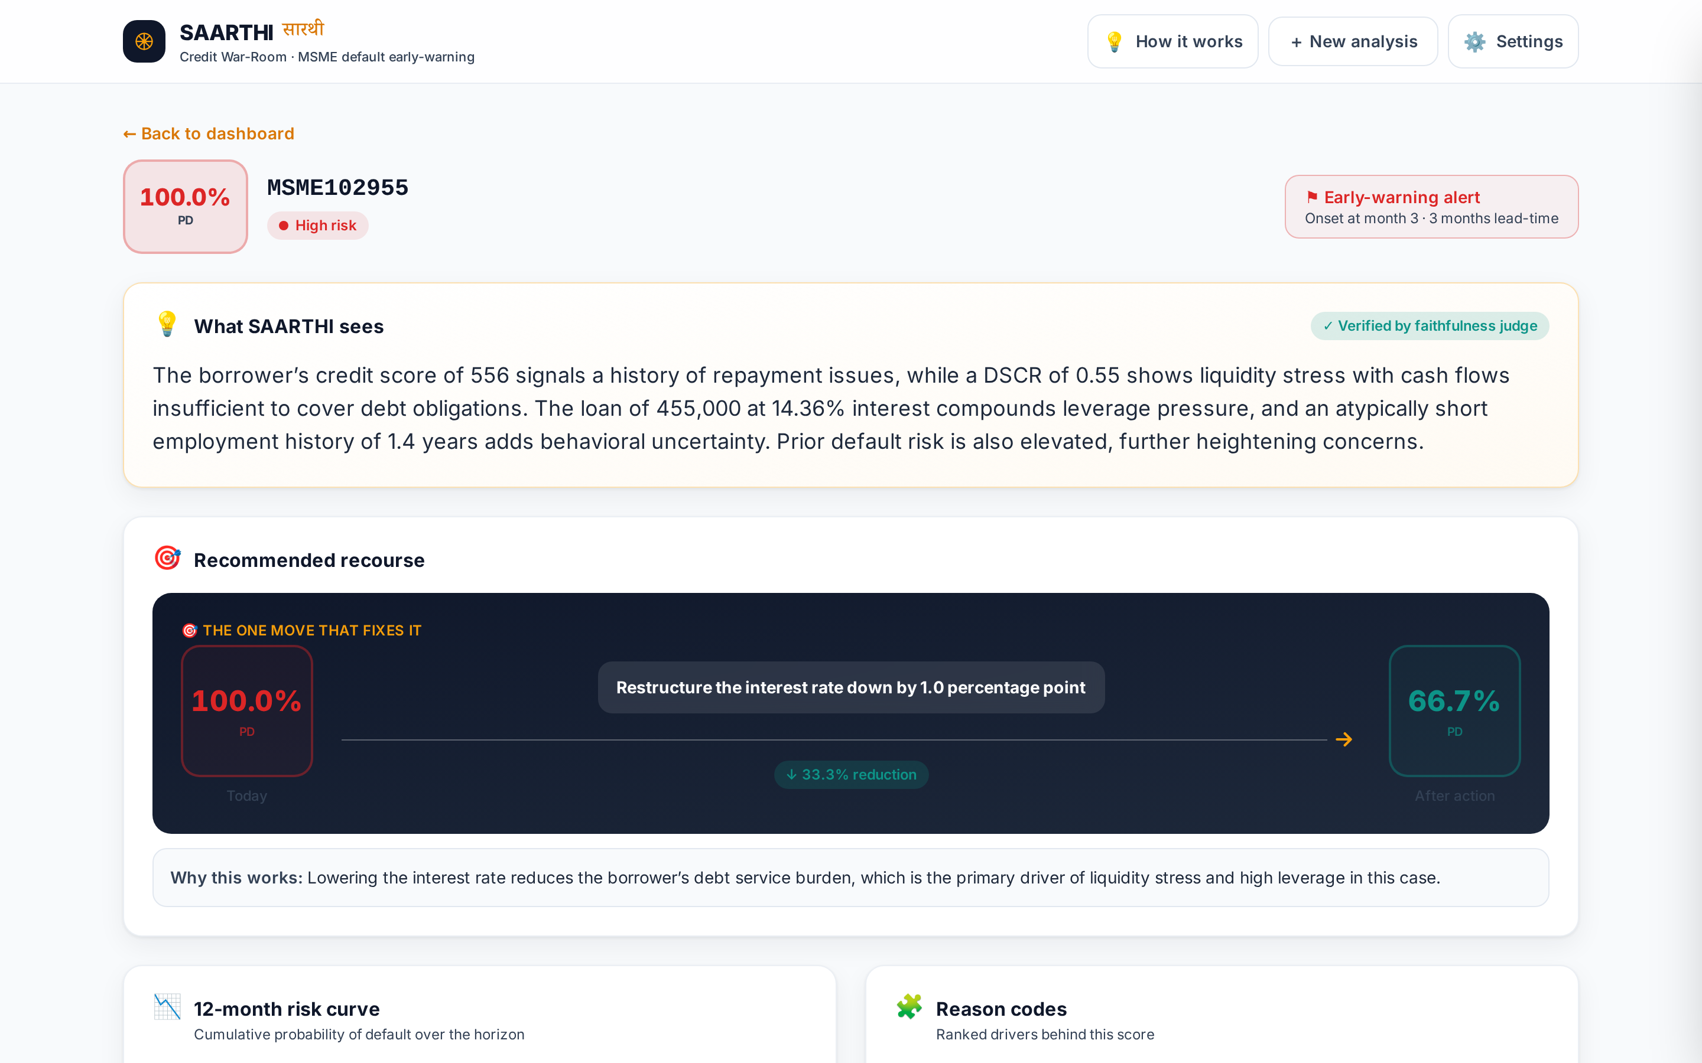
Snapshots of the prototype
Live at https://koushikdeb.duckdns.org — portfolio dashboard (left) and per-loan reasoning with verified reason codes, 12-month risk curve and recommended recourse (right).

Slide 11
Prototype Performance report/Benchmarking
All figures on an untouched test fold. Data is split three ways — 60% fit / 15% calibrate / 25% test — so the isotonic calibrator never sees the fold used to report calibration error. Reporting ECE on the calibrator's own fold (a common shortcut) drives it artificially to zero.
Dataset (public benchmark) | Test AUC | ECE | Published ref.
Sba | 0.9800 | 0.0015 | ~0.95
Amex | 0.9580 | 0.0050 | ~0.96
Gmsc | 0.8522 | 0.0041 | ~0.87
Taiwan | 0.7698 | 0.0074 | ~0.78
Home Credit | 0.7632 | 0.0011 | 0.805
Lending Club | 0.7263 | 0.0024 | 0.70-0.73
Pooled global model | 0.8605 | 0.0018 | —
Transaction-as-language ablation: on Berka (16 tabular features) the sequence embedding adds +0.0267 AUC (0.8575 → 0.8842); on Amex (941 engineered features) it adds nothing — it substitutes for feature engineering rather than adding to it.
Cross-domain transfer (negative result): leave-one-dataset-out mean AUC 0.5377 — a single pooled model does not transfer across lending domains, which is why SAARTHI fine-tunes on the lender's own book.

Slide 12
Additional Details/Future Development (if any)
Ready for the IDBI sandbox
The pipeline is already written against IDBI's published API schemas — API 402 (DPD / NPA status) supplies the training label, API 393 (statement with narration) feeds the sequence encoder, and APIs 391 / 408 / 441 / 442 / 362 supply loan, bureau, limit and lien features.
Next
• GST-behavioural features — filing delays, turnover trend, ITC mismatch, customer concentration — modelled on the Bank's own schema.
• Public-domain digital signals for thin-file MSMEs, gated by an explicit borrower-consent flag under the DPDP Act, 2023.
• AWS Bedrock adapter so explanation and judging run entirely inside the Bank's VPC.
• Portfolio-level what-if: simulate a policy change and see the projected shift in expected credit loss.

Slide 13
Improvements done during the 2nd Prototype phase
Trained a real model. Phase 1 trained only on whatever file was uploaded. SAARTHI now ships pre-trained on 3.3M loans across nine public corpora and fine-tunes on the lender's book.
Fixed a calibration-evaluation flaw. The earlier build fitted the isotonic calibrator and measured calibration error on the same fold, which understates it. Now a strict three-way split; every reported number comes from data neither the model nor the calibrator has seen.
Found and removed a data leak. On the Berka corpus, 71% of an account's transactions post-date the loan and encode the outcome, giving a false AUC of 1.0000. Aggregation is now restricted to pre-origination activity; the honest figure is 0.8558.
Built transaction-as-language. A self-supervised contrastive encoder trained on 13.25M transaction events; on a frozen embedding alone a linear probe reaches 0.8717 AUC.
Verified rather than assumed. Ensembling correlated boosters was measured, found to add nothing (−0.0029 AUC), and reported as such.

Slide 14
Provide links to your:
GitHub Public Repository: https://github.com/DevDaring/IDBI_SAARTHI
Demo Video Link (3 Minutes): https://youtu.be/WGtfB9VSff4
Final Product Link: https://koushikdeb.duckdns.org
Trained models (public): https://huggingface.co/Debk/saarthi-default-prediction

Slide 16


